Slide 1
Download .NET 8
https://aka.ms/get-dotnet-8

Slide 3
Building 3D apps with .Net MAUI and Evergine
Jorge Canton – Plain Concepts
Javier Suarez – Microsoft
Notes:
Javier Suarez
Hello everyone and welcome to this session, my name is Javier Suarez and I’m a Microsoft MAUI engineering and I'm joined by my good friend Jorge Cantón, who is Research Director at Plain Concepts. Plain Concepts is the company behind the technology that we are going to discuss today.
Ok, Let’s begin without further delay, In this session, we will learn how to build 3D apps with .Net MAUI and Evergine. Evergine is an industrial cross-platform graphics engine that you can use now together with .Net MAUI. Perhaps you've considered creating an e-comerce mobile app with 3d models for its products or a shopping mall mobile app that allows users to explore a 3D map. The ability to include 3D assets in .NET MAUI has been one of the most requested features within the .NET MAUI community. Now, all of this and more is possible with .NET MAUI and Evergine.

Slide 4
.NET MAUI
SDK-style projects
Single Project
CLI Support
Visual Studio Windows and Visual Studio Code
Hot Reload
DESKTOP
MOBILE
.NET MAUI
Windows
iOS
File | New
Multi-platform App UI (.NET)
CLI
dotnet install maui
dotnet new maui
Namespace
Microsoft.Maui
macOS
Android

Slide 5
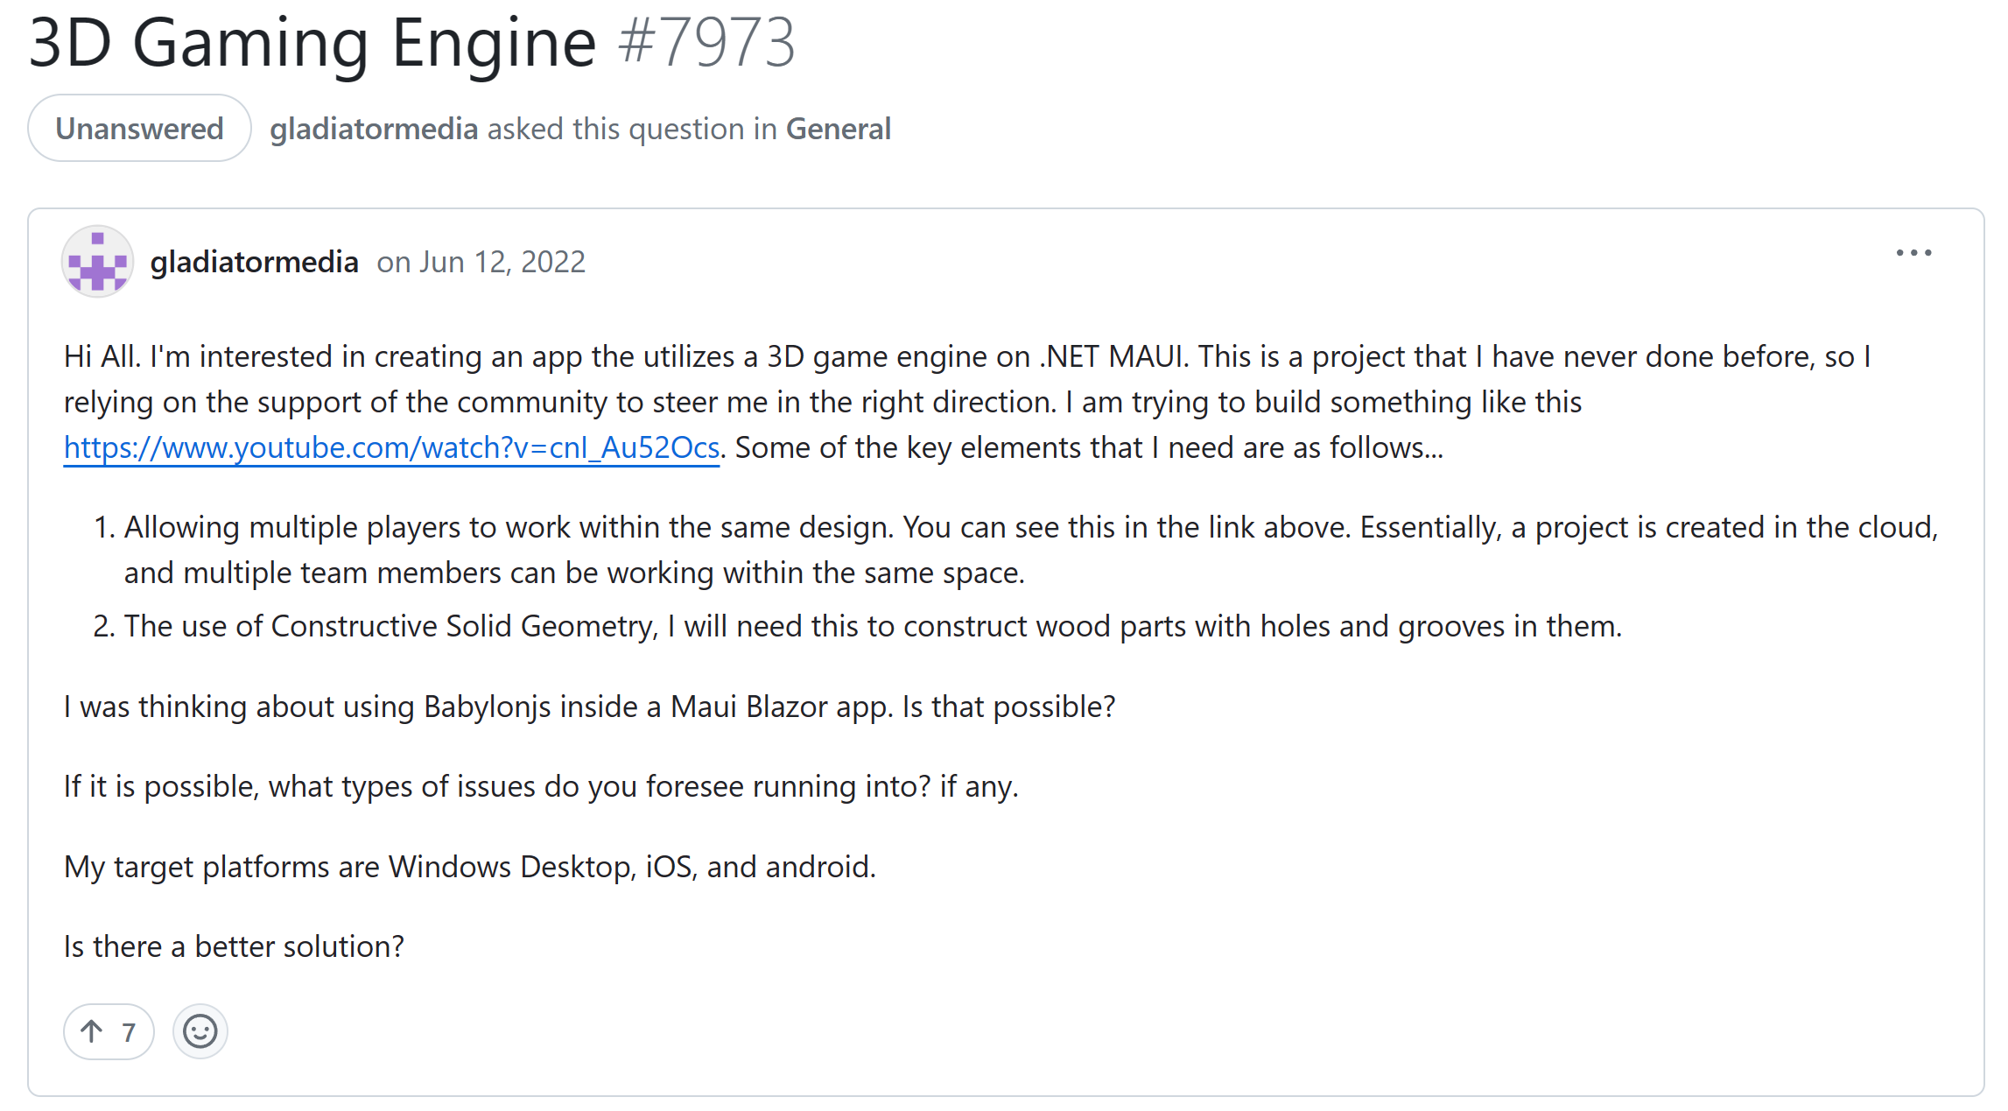
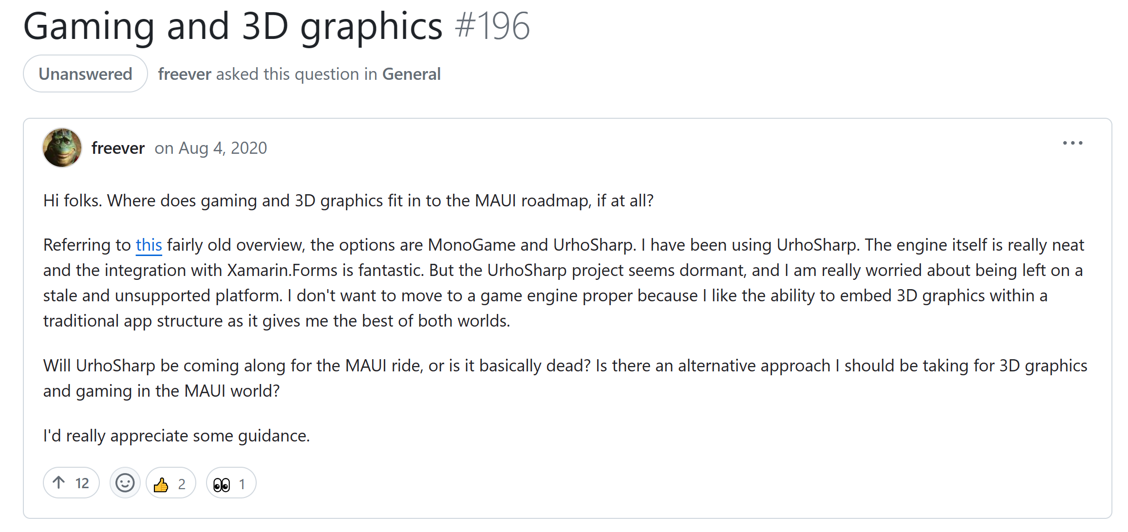
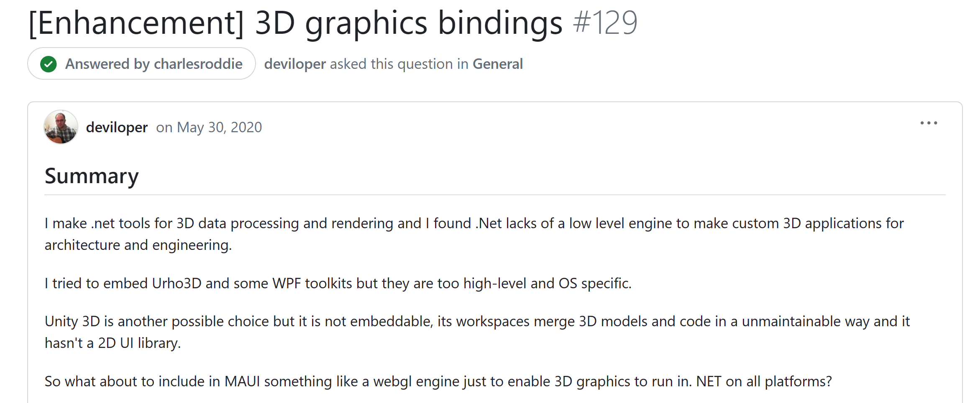
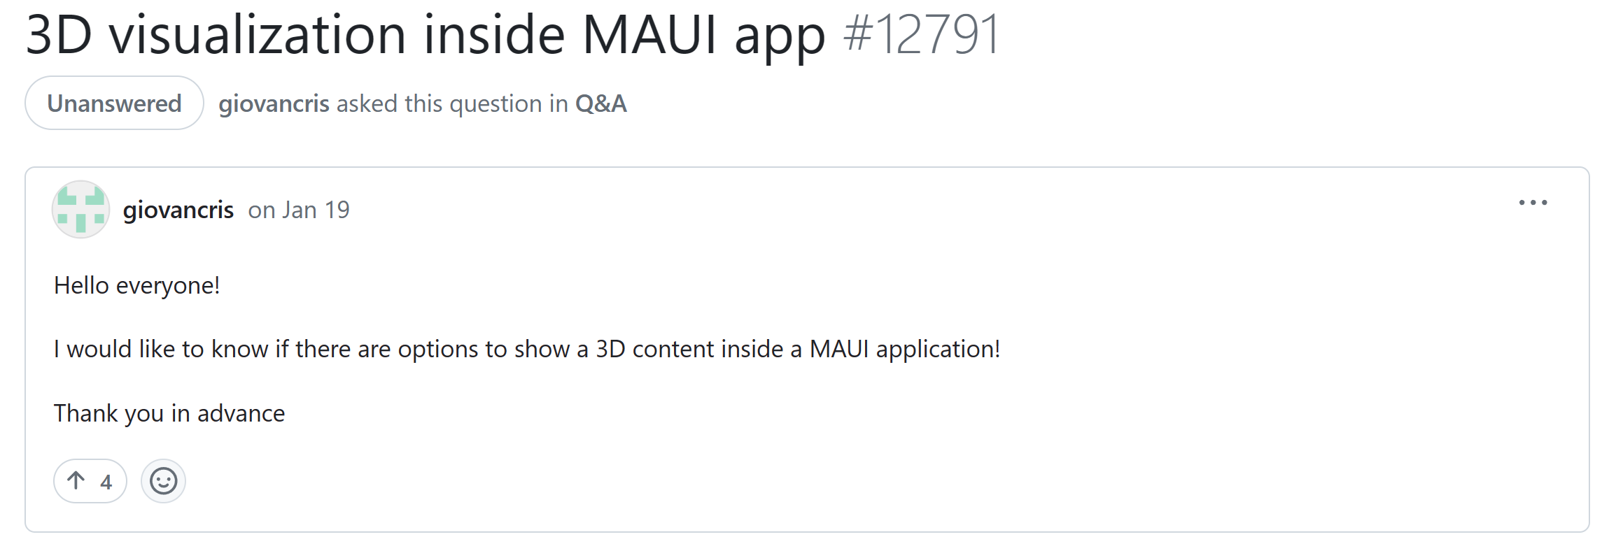
There were a huge number of requests…
Notes:
Javier Suarez

Slide 6
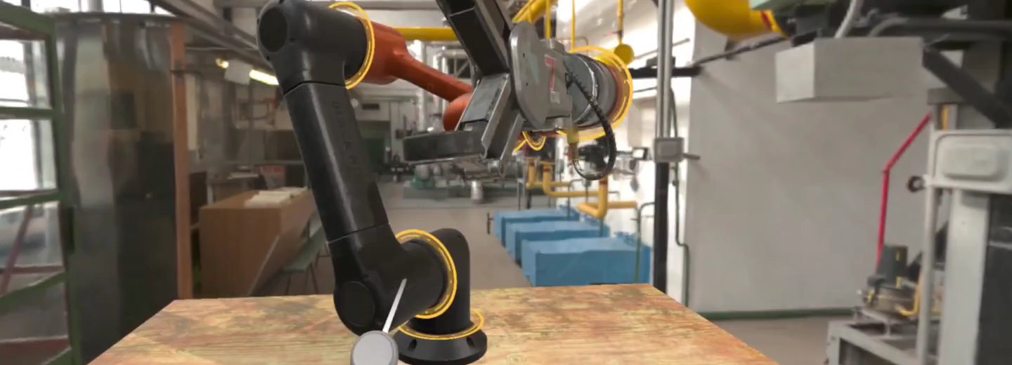
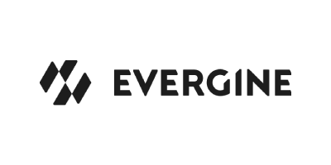
What is Evergine?
Notes:
Jorge Cantón
Evergine is an industrial cross-platform 3D engine developed in C sharp. Evergine is being used on industries such us aerospace, architecture, healtcare, energy or entertainment among others. In this video you can see some examples.
Like digital twin, virtual training, holographic events or industrial simulations. All of these project are using Evergine right now. Once of the most important feature of Evergine, it's so flexibible to integrate with other tecnologies, so you can use it to enhance your both new and existing applications with 3D content. And now in the latest version of the Engine you can use .Net MAUI as well.

Slide 7
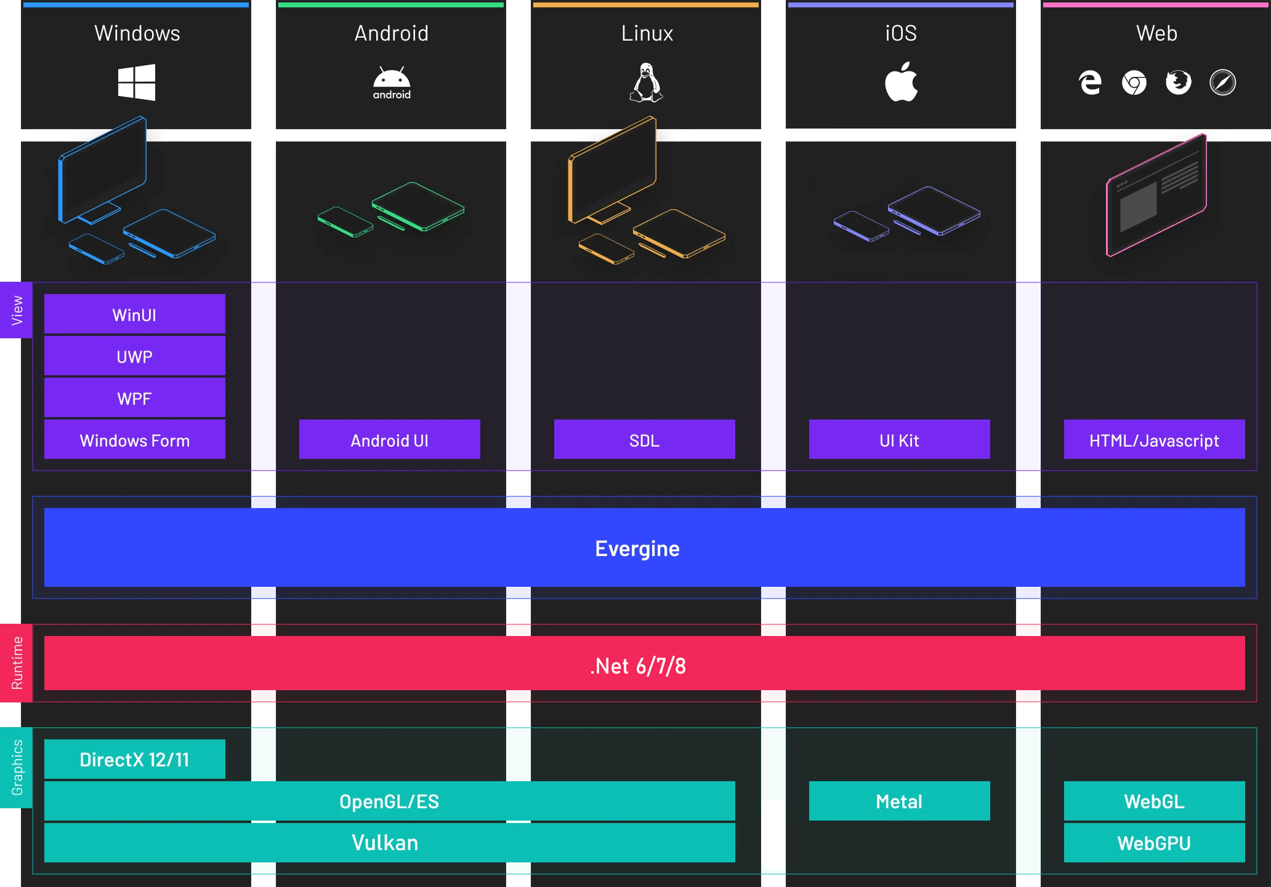
Evergine architecture
Notes:
Jorge Cantón
Let's take a closer look at the Evergine architecture. Evergine includes binding pretty much any graphics library, DirectX 11/ 12, OpenGL, Vulkan, Metal and WebGL and comming soon WebGPU too.
Written in C#, Evergine is committed to keeping pace with the latest .NET versions and tools, ensuring the best possible experience for our users. On top of this architecture, Evergine includes integration with a wide range of platforms including Windows, Android, Linux, IOS, Web and augmented reality and virtual reality platform such as Hololens, Meta Quest or Pico. So you can use Evergine as a cross-platform 3D tier to make your apps.

Slide 8
Evergine’s use
Free to use
No Licensing fees
No Royalties
Comercial and non-comercial projects
Notes:
Jorge Canton
And Finally, we are going to talk about the license. Evergine is completely free to use, with no licensing fees and no royalties, making it suitable (adecuado) for both commercial and non-comercial projects. For the other side, to be clear, Evergine's business model revolves around providing additional services such as:
- Priority support: The engineering team provide assitance and technical support for any questions or problems you may have using Evergine.
- Source code Access: That give you total access to the engine source code.
- And Professional Sevices that includes training sessions, one to one session, proof of concepts and new features according to your needs.
That is all, but if you have any question you can checkout the Evergine website or write an email to info@evergine.com

Slide 9
Demo
Getting started with MAUI and Evergine
Notes:
Jorge Cantón
Now, We are going to start with our first project using .Net MAUI and Evergine from scratch.

Slide 10
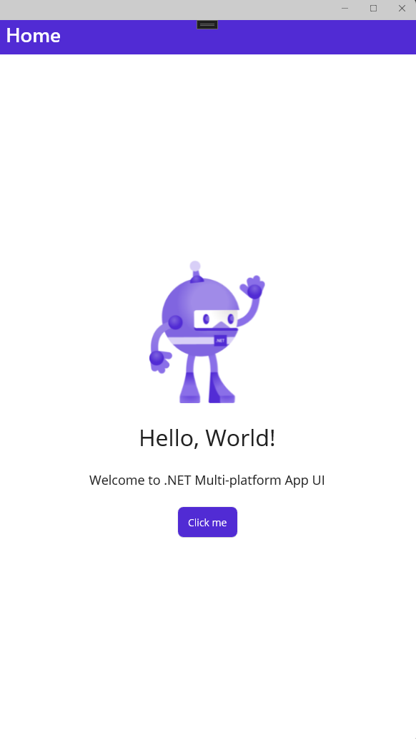
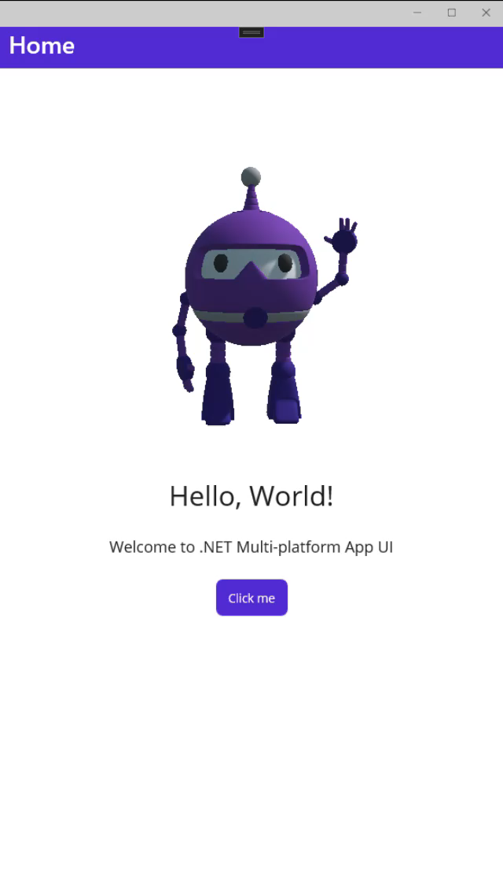
Convert to 3D
Source: https://github.com/Jorgemagic/MAUIDotnetBot
Notes:
Jorge Canton
The goal for this demo is to create a mobile app using .Net MAUI that include 3D assets. To do so, we are going to extend the default .Net MAUI template project with 3D content.
Let’s me share my screen with you. Once you have installed Evergine on your windows PC. The first that you see will be Evergine launcher. The Evergine launcher allows you manage the different engine versions, open and update projects and provide you and quick access to documentation and samples. But we are going to start from the beginning, so we are going to push the button “Add new Project” here. And now we need to type our Project name, we use “My first Project”, the Project location and the Evergine versión that we want to use. And finally, we need to select the platfoms and template that we want to use for our Project. Now we going to use the platform filter to search the MAUI template and we check this Project template to add to our Project.

Slide 11


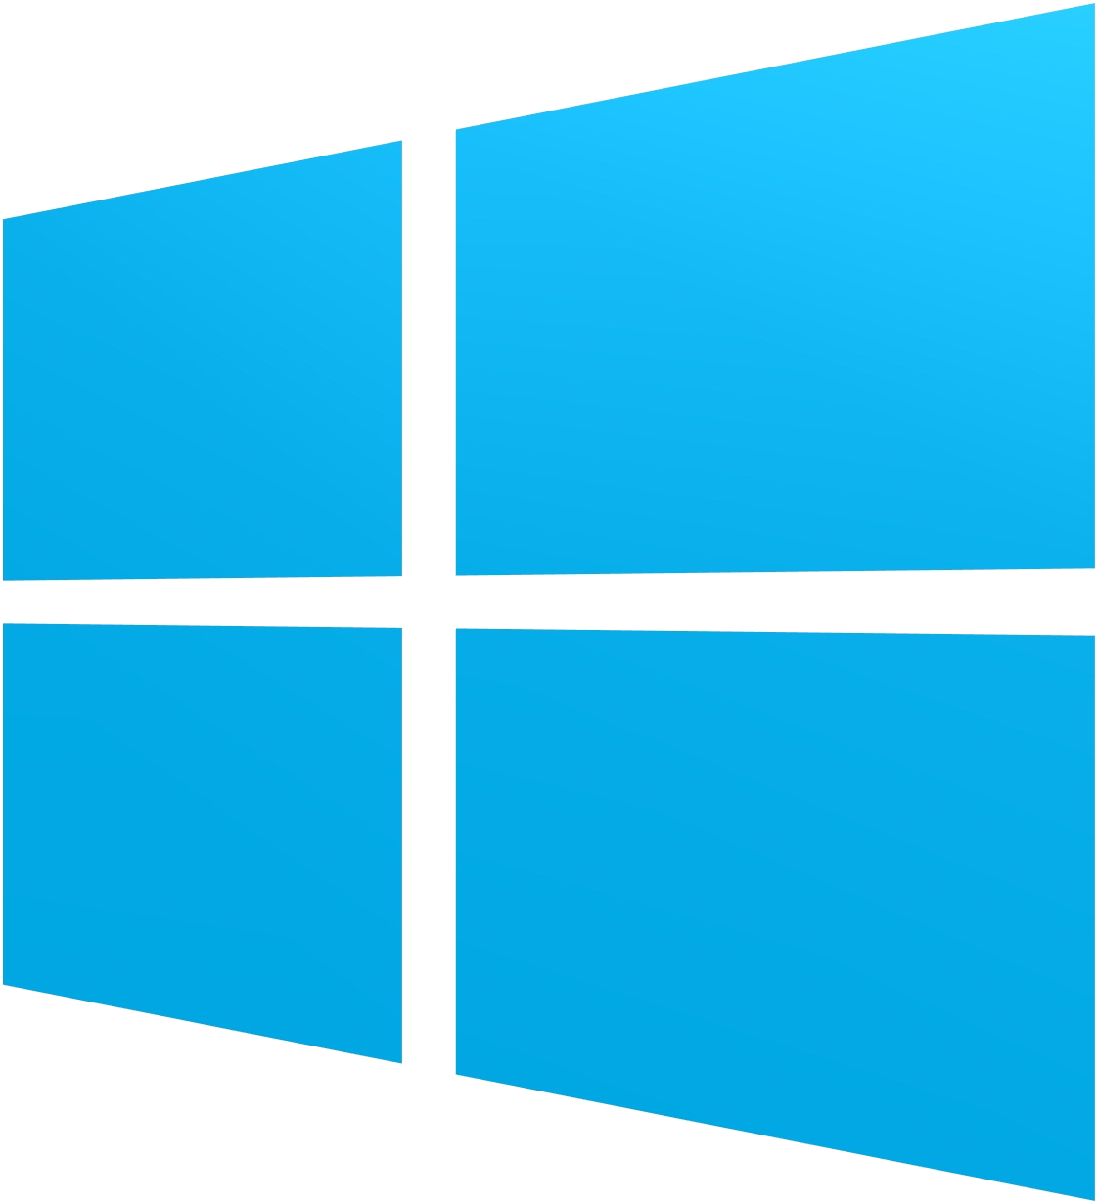
How it works
EvergineViewHandler
(AndroidSurfaceView)
Vulkan
EvergineView
EvergineViewHandler
(SwapChain)
Metal
Evergine Application
EvergineViewHandler
(SwapChainPanel)
DirectX
Notes:
Javier Suarez

Slide 12
Demo
MAUI and Evergine showcase app
Notes:
Jorge Canton
In the previous demo, we demostrated how to create a .Net MAUI application containing 3D content. Now I'd like to show you a more complex demo where users can interact with the 3D content. This demo is use to showcase an e-commerce mobile application and how to comunicate betwen .Net MAUI to Evergine 3D content.

Slide 13
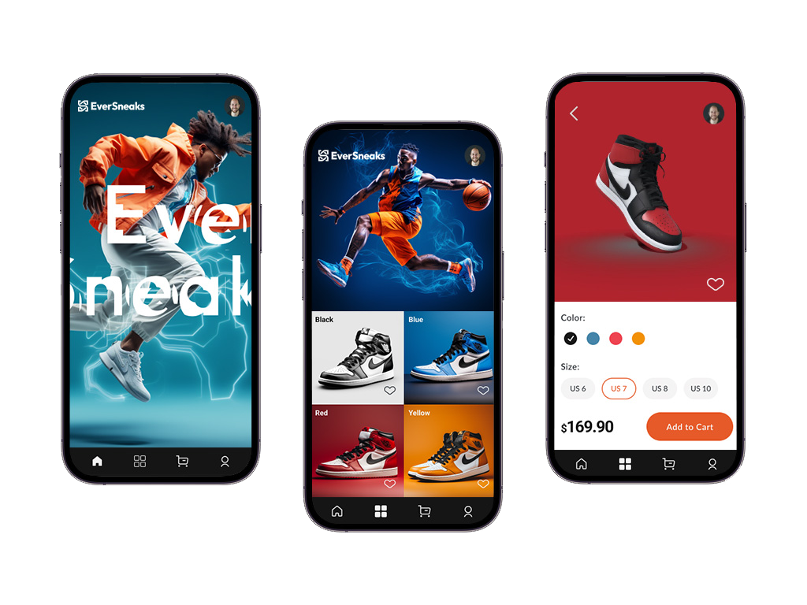
Source: https://github.com/EvergineTeam/EverSneaks
Notes:
Jorge Canton
This is the design of our e-commerce movile app, Fun fact, all the images of this demo were automatically generated using AI. All regarding the AI is so crazy now :), Well, we have 3 different screens, home or main screen, a gallery view with a collection of sneakers and a product detail view. Where users can explore a product from different angles, change its color and size and add it to cart. So The third screen contains the 3D canvas and the users will be able to interact with it changing the color.
Alright, let's switch to Visual Studio 2022.

Slide 14
Customer story
Brain – Thera4all
Notes:
Jorge Cantón
Now Let me introduce you to the first commercial application created using .Net MAUI and Evergine.

Slide 15
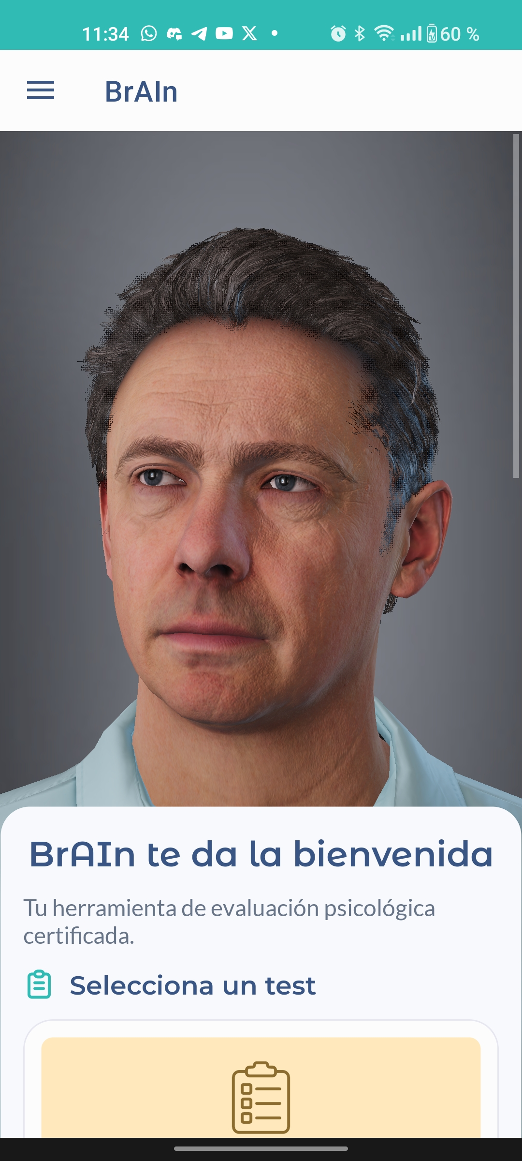
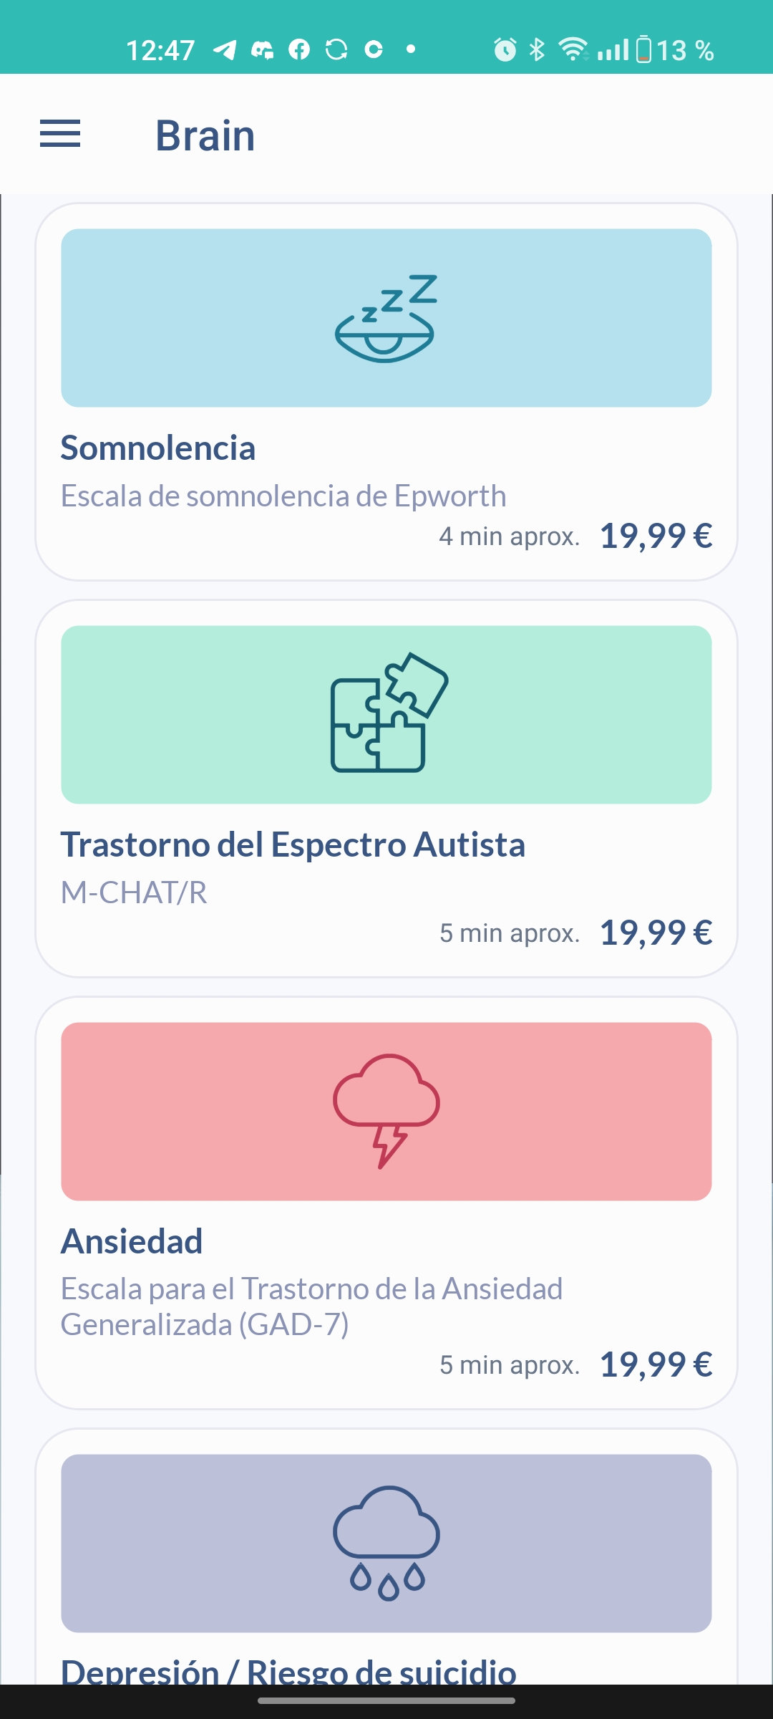
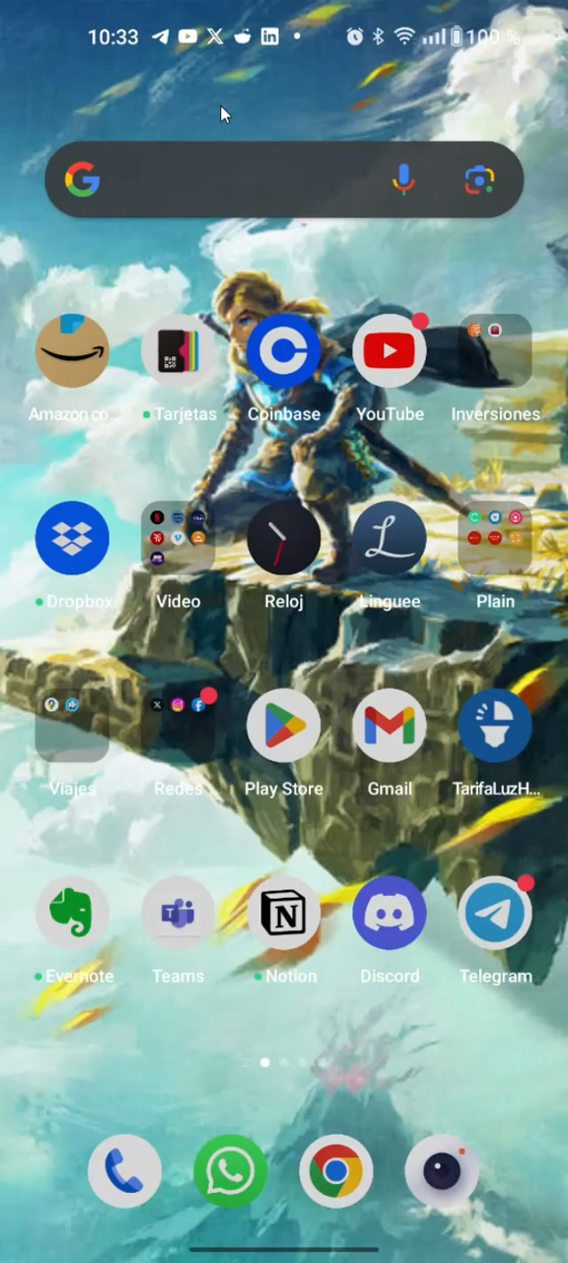
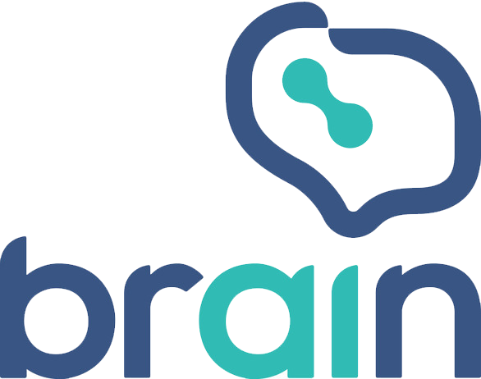
Thera4All
Notes:
Jorge Canton
Brain is mobile app for Android and IOS focused on mental health. It provides users with a collection of psychological assessment tests that they can use to evaluate themself. All the user interface was created using .Net MAUI combined with a 3D virtual avatar using all the power of Evergine. When a user opens the application, he will be welcomed by this virtual avatar and you can speak with him. To achieve that, Brain uses OpenAI technology to add intelligence to the avatar and Microsoft Cognitive Services to reproduce its human-like voice. In this video you can see how all theses technologies fit seamlessly.

Slide 16
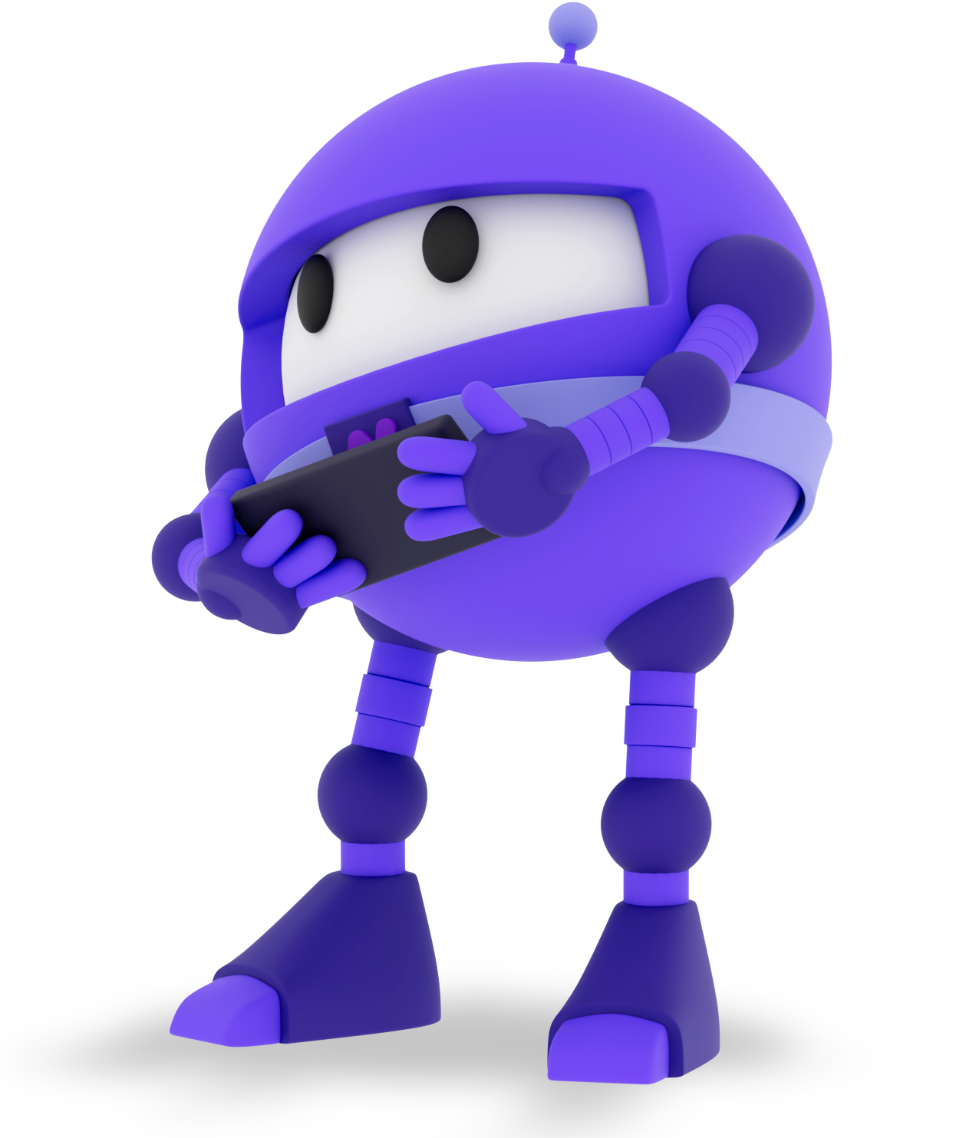
Resources
Evergine https://evergine.com/
.Net blog post https://devblogs.microsoft.com/dotnet/dotnet-maui-3d-app-with-evergine/
DotnetBot demo code https://github.com/Jorgemagic/MAUIDotnet
EverSneaks Showcase code https://github.com/EvergineTeam/EverSneaks
CarRental App UI Challenge https://github.com/jsuarezruiz/netmaui-carrental-app-challenge
Notes:
Jorge Canton
And that's all. We would like to share some interesting resources with you, and we hope you enjoyed this session.
Javier Suarez
We are excited to see what you can create by combining Evergine and .NET MAUI.
Happy coding! bye

